Slide 1
Help turn Fort Independence Park into a sponge!
Be the City’s imagination and prepare Green Infrastructure drawings based on the photos of runoff damage
REGISTRATION PACKET

Slide 2
Enter the Park into Sponge Contest
Email: parkintosponge@bceq.org with your name, phone, & affiliation.
Be the City’s imagination and prepare Green Infrastructure (GI) drawings based on the photos of runoff damage supplied in the registration packet.
Or use your own park and take your own photos and prepare GI to turn your Park into a Sponge.
Bring your final exhibit to the meeting (set up is 5 pm on April 10).
Make sure you make a reservation for your poster boards, power point or storyboard. Judges will be reviewing your project at this time.
Winners will be announced in at our Environmental Education Awards Board Meeting in June 8, 2019.

Slide 3
What is Green Infrastructure?
Here is a great video from federal EPA: https://www.youtube.com/watch?v=IQw1ohQjslE
Here is a great video from NYC’s DEP: https://www.youtube.com/watch?v=zrhw2cMTpJs
Here is some good reading: https://www.nrdc.org/sites/default/files/catalyzing-green-infrastructure-on-private-property.pdf
Extra Credit for those interested incentivizing Green Infrastructure with lower water fees. Here is a good report on Water affordability: http://mannyteodoro.com/wp-content/uploads/2014/03/Teodoro-JAWWA-2018-affordability-methology.pdf

Slide 4
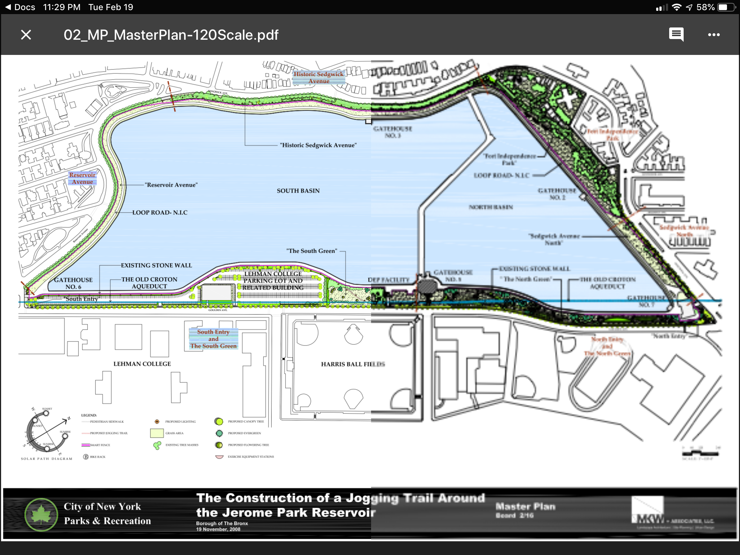
Fort Independence Park is along Jerome Park Reservoir in the northwest

Slide 5
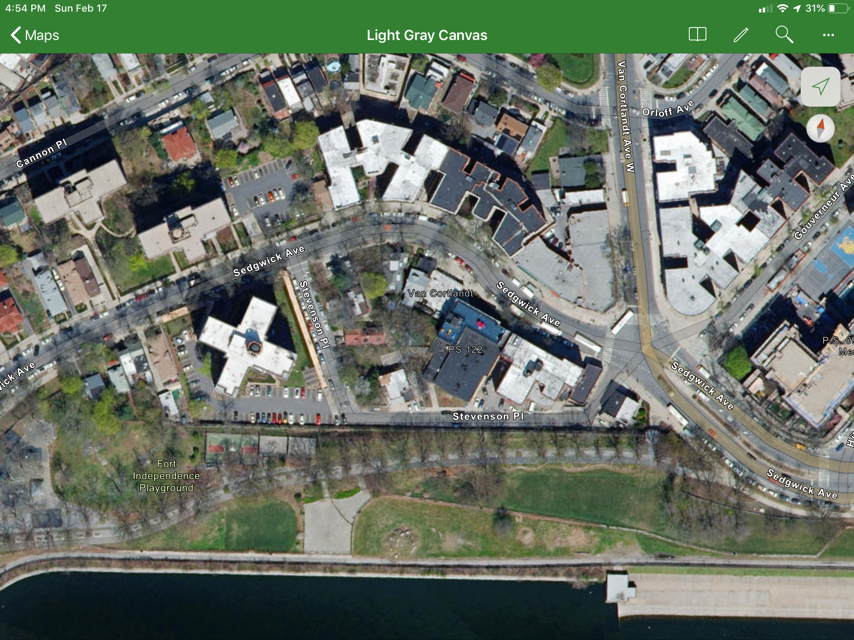
Fort Independence Jogging Path

Slide 6
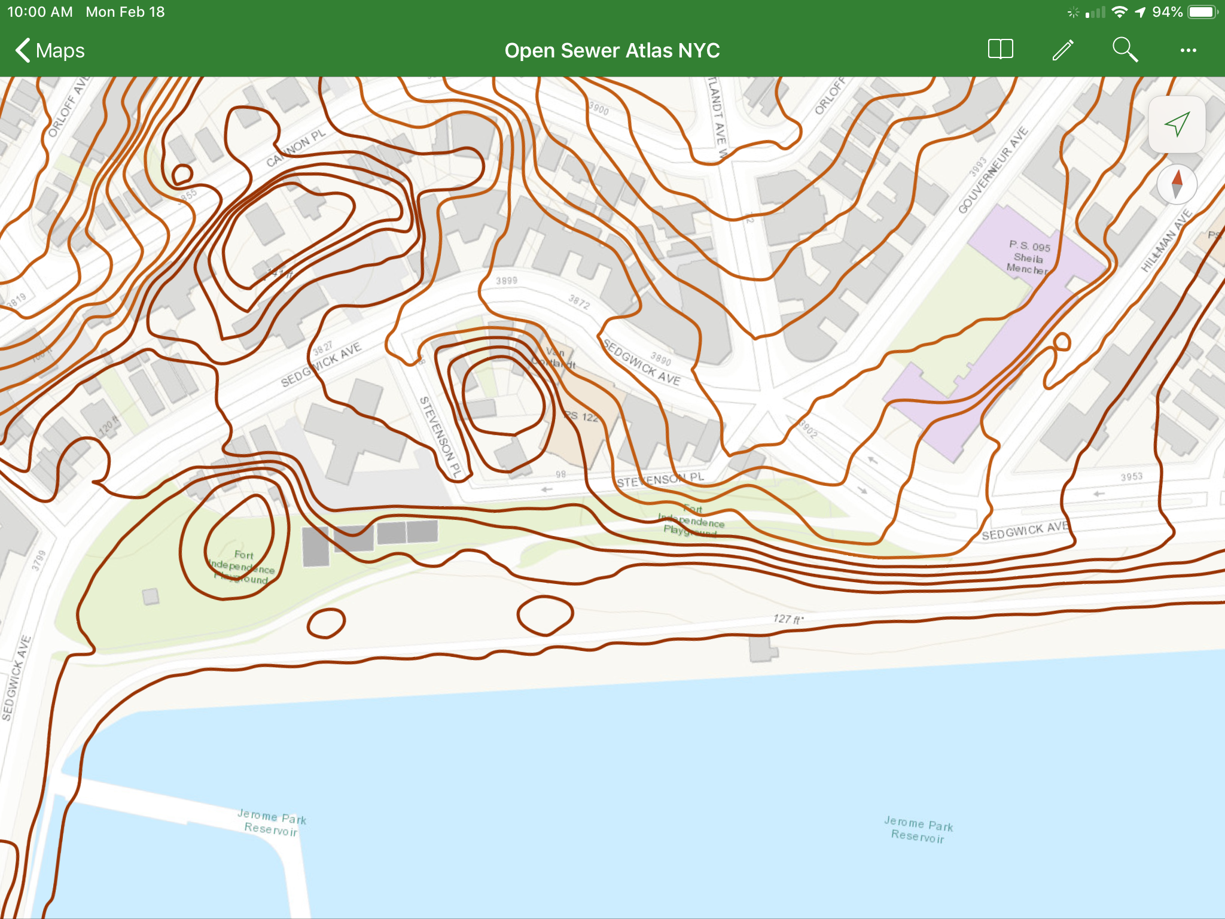
Topography of the Jogging path in the green area of Fort Independence Park

Slide 7
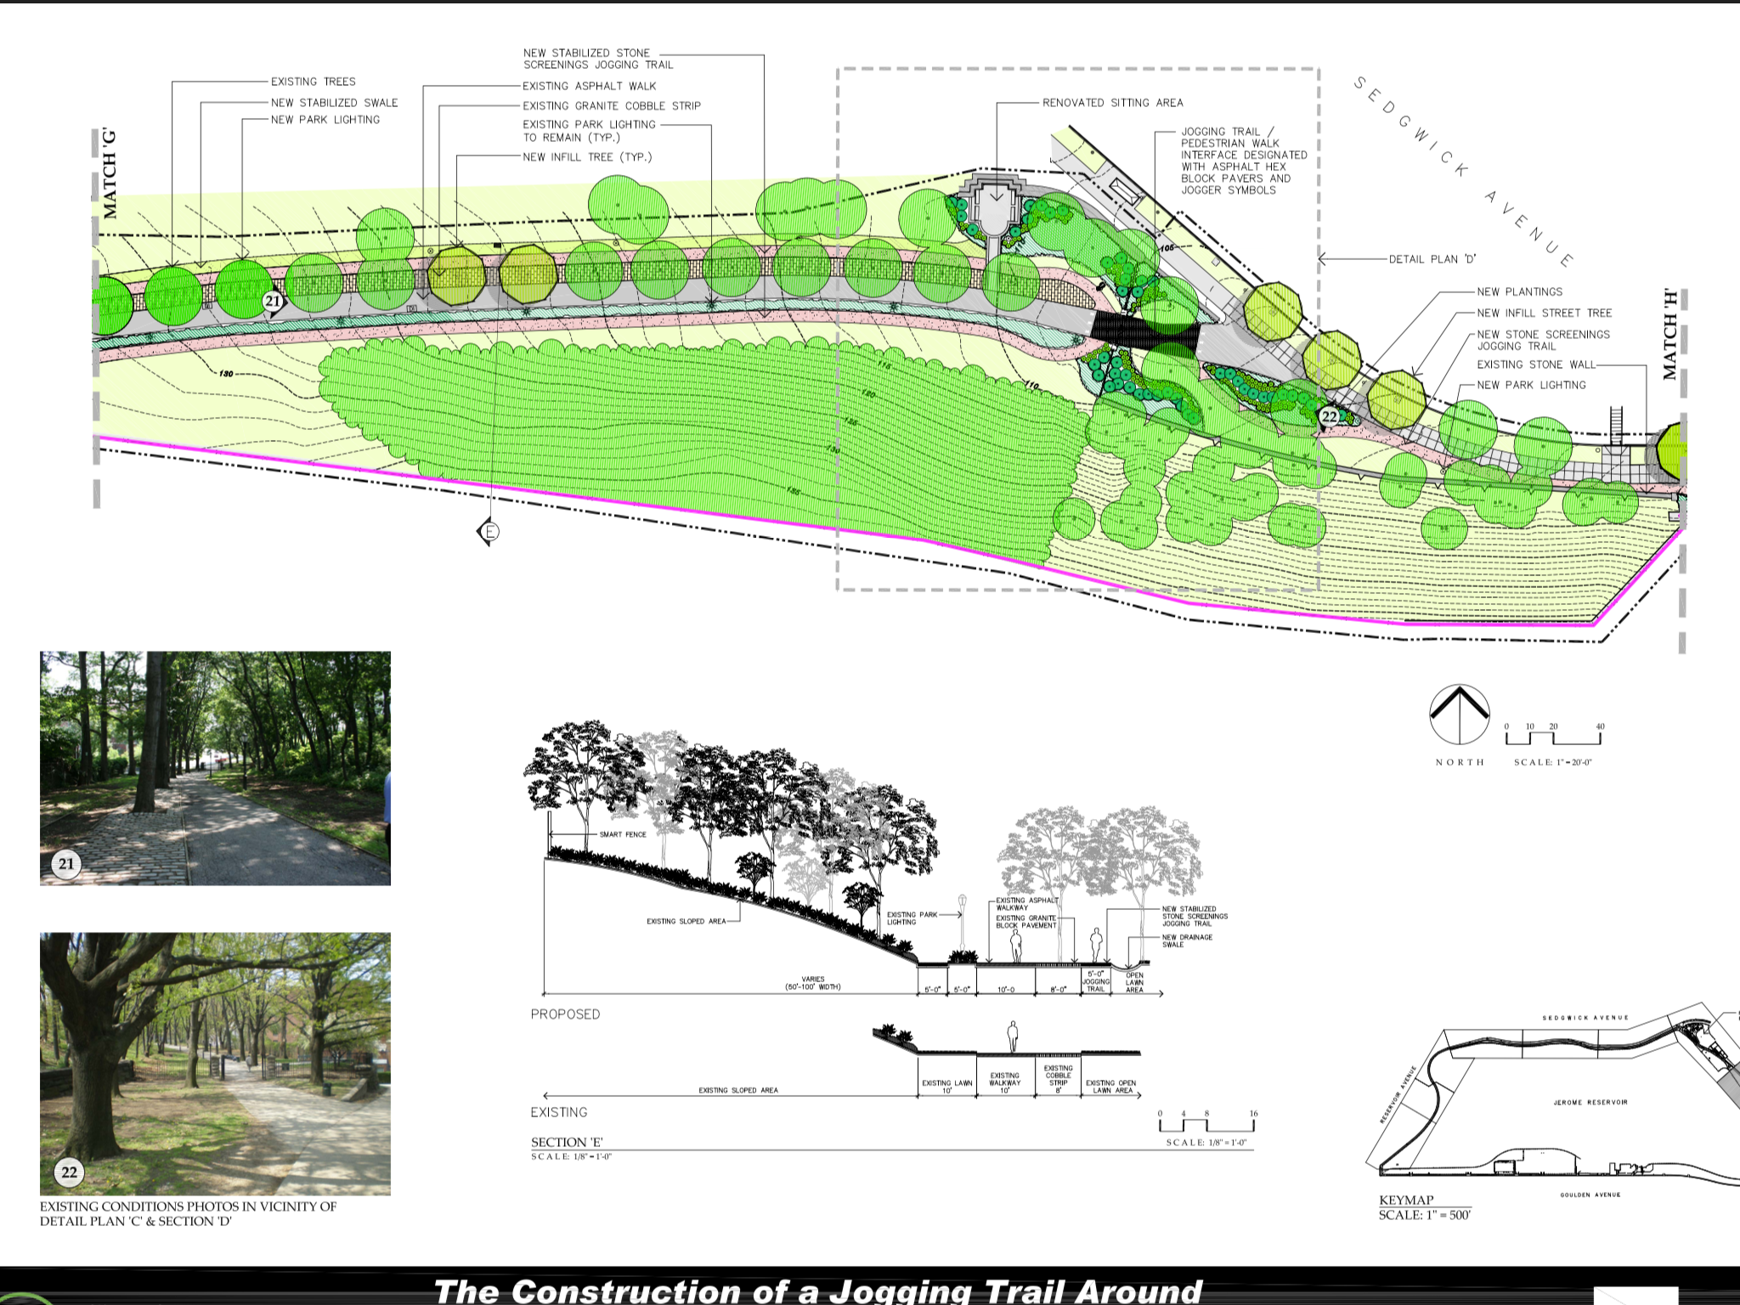
Proposal and existing conditions for the latest pathway re-construction

Slide 8
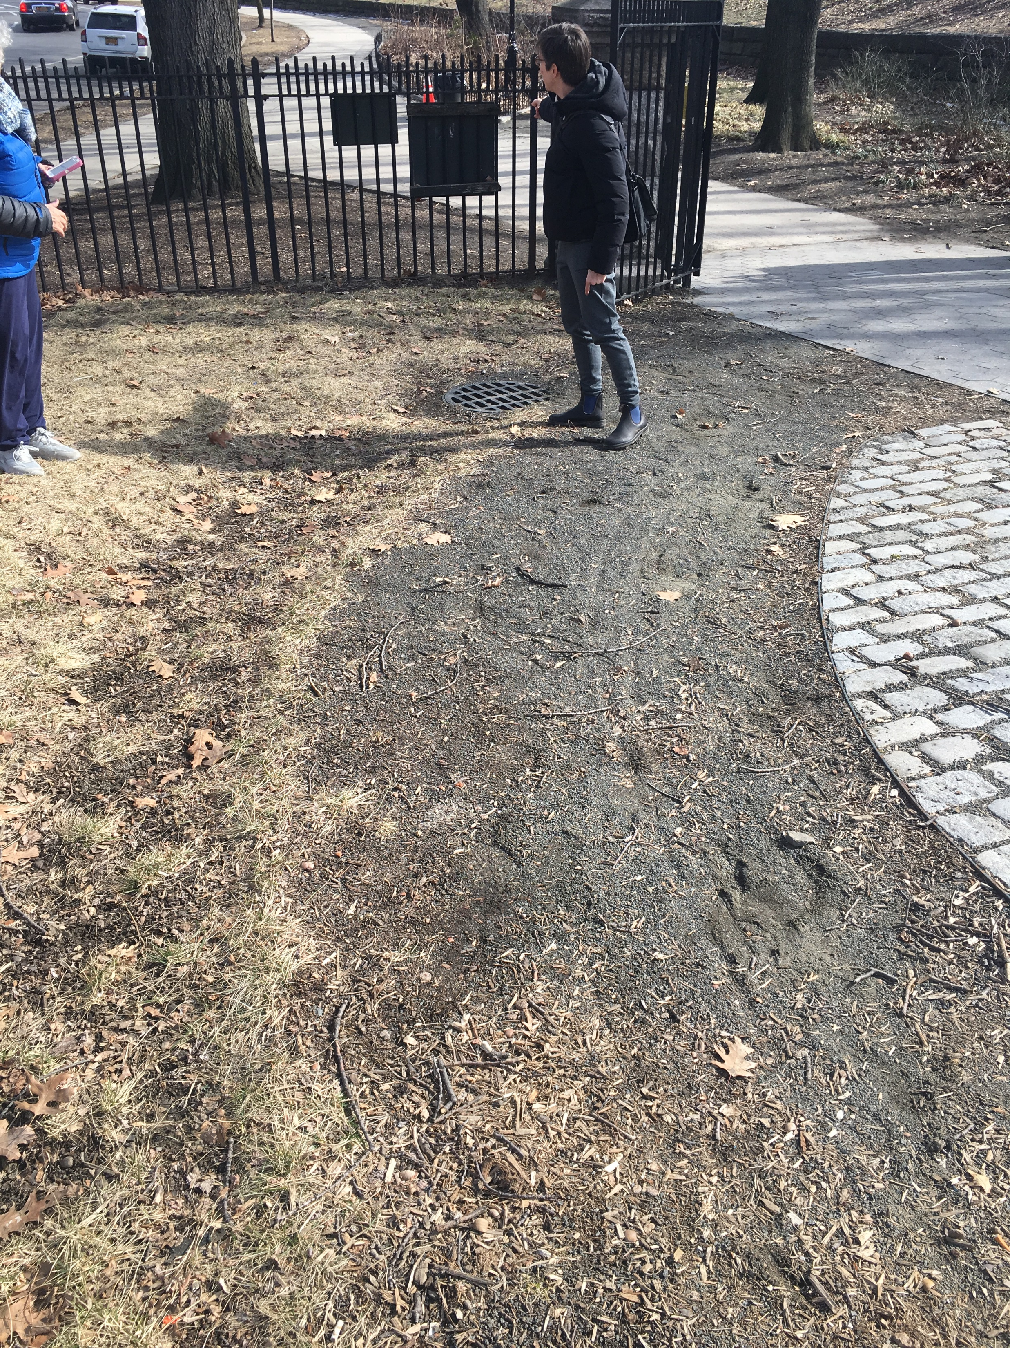
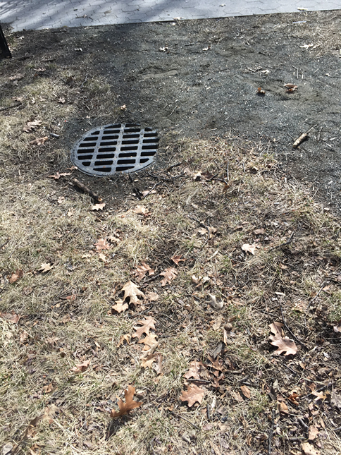
Existing conditions at entrance

Slide 9
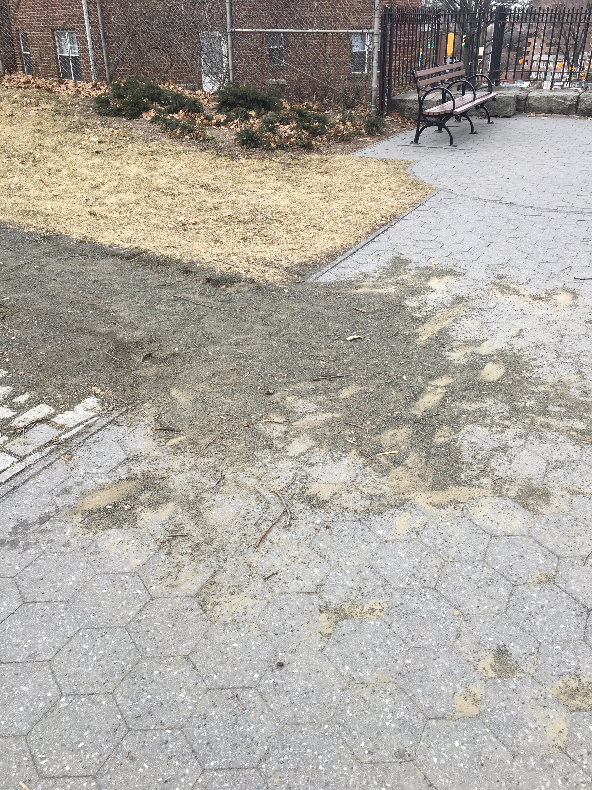
Existing conditions along jogging path
Looking west at sitting area
Looking downhill – note small edge at Belgium blocks

Slide 10
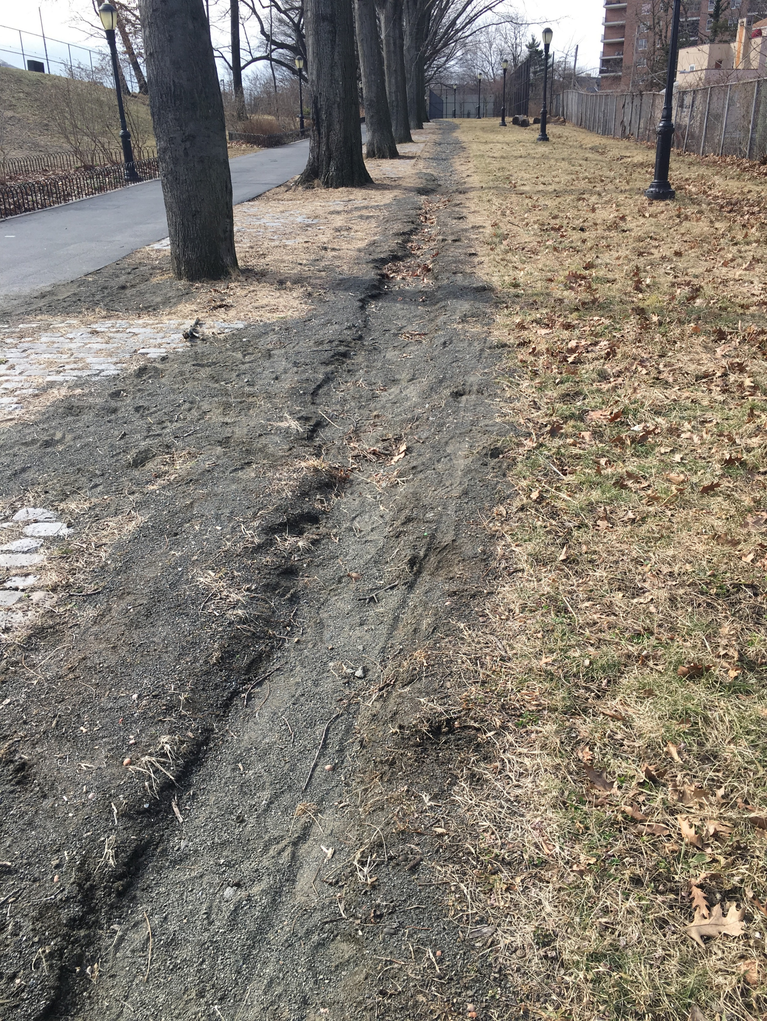
Existing Conditions
Looking downhill
Looking uphill

Slide 11
Quick drawing:
blue lines are jogging path
green lines are probable runoff
red X are barrier from rain not working

Slide 12
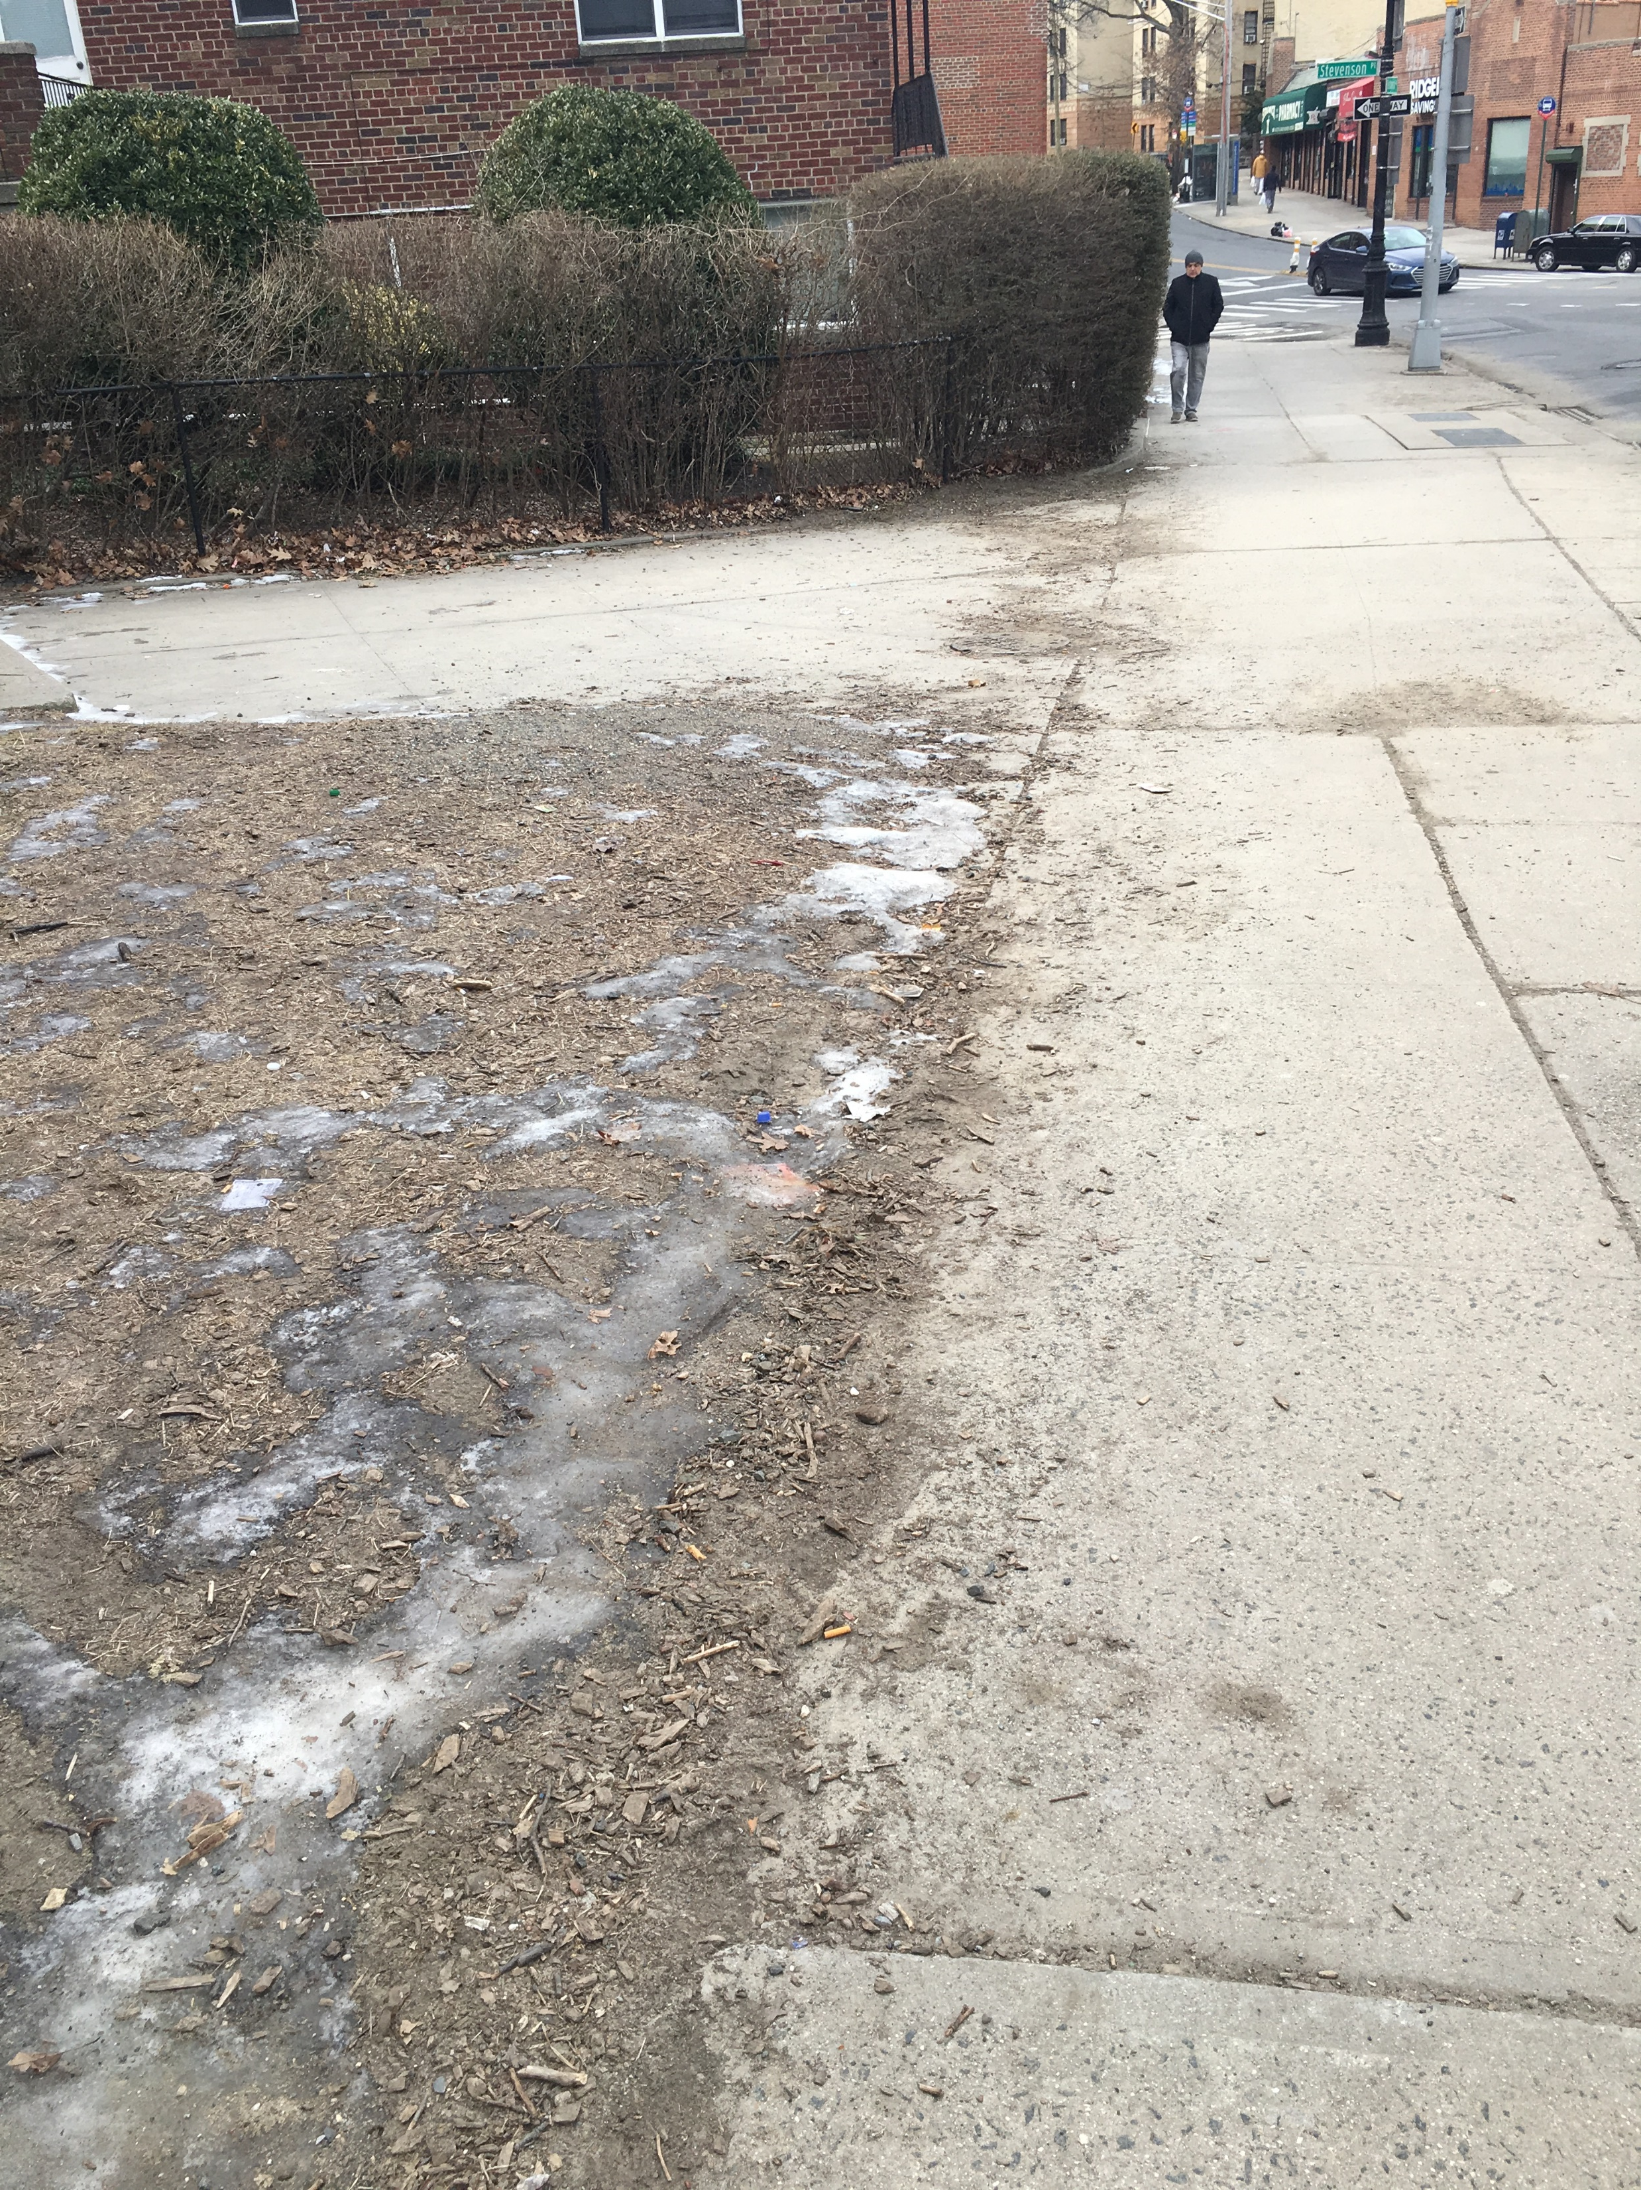
Existing Condition outside the park at the bus stop on Sedgwick Avenue

Slide 13
Good Luck & Thank you
Don’t forget to sign up
Bring your final exhibit to the meeting (set up is 5 pm on April 10). Exhibit is from 6 to 6:55 pm.
Make sure you reserve a table for your poster boards. Judges will be reviewing your project at this time.
Winners will be announced in at our Environmental Education Awards Board Meeting in June 8, 2019.
Check out our web page at www.bceq.org

