Slide 1
New York City Water Supply Operations
Croton Facility Monitoring Committee
Adam Bosch, Director of Watershed Public Affairs
January 28, 2019

Slide 2
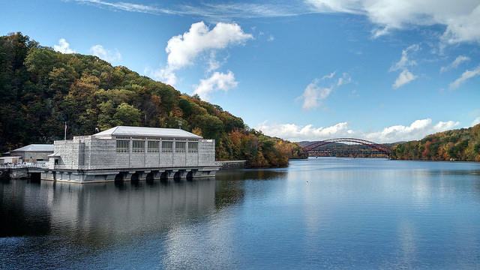
Presentation Agenda
Water supply overview
Water supply operations
Croton Water and infrastructure work
2018 taste and odor issue
Croton Water then and now
Questions and discussion

Slide 3
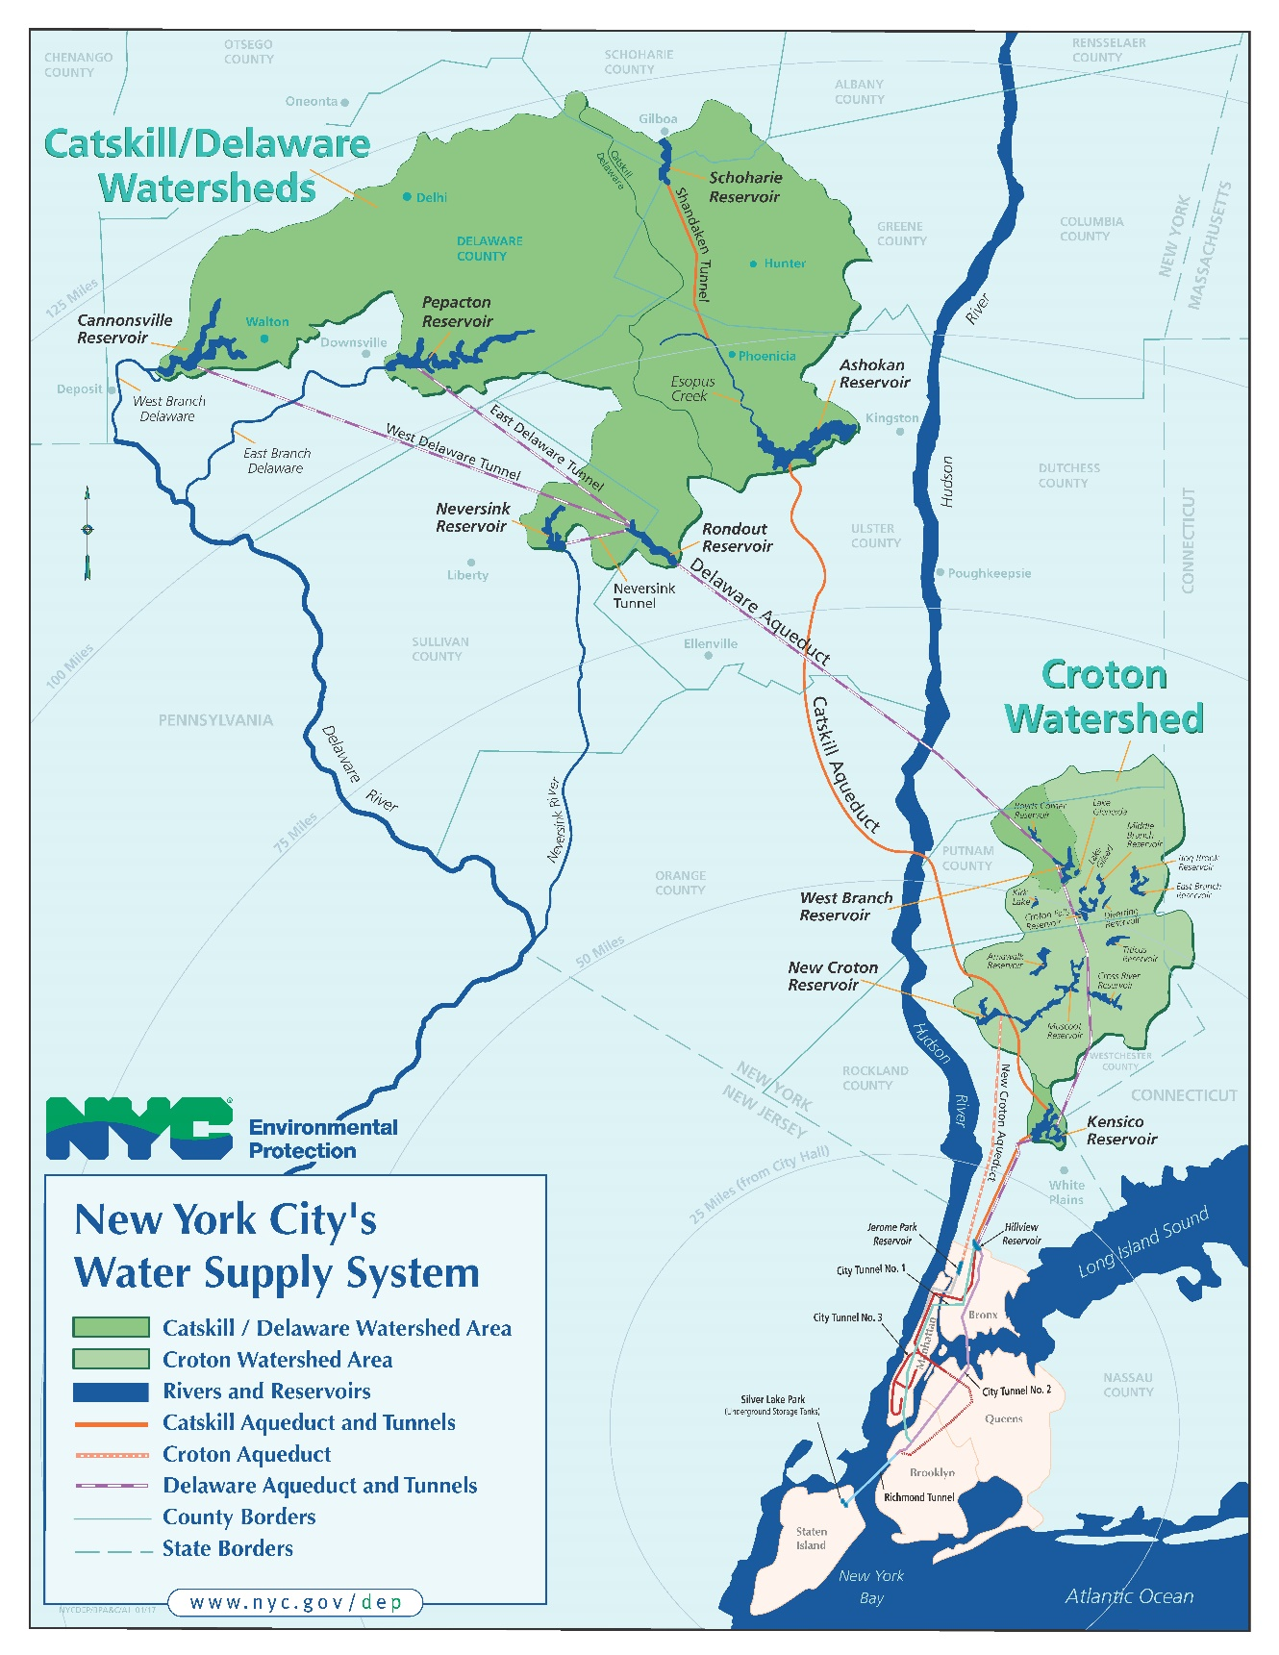
Primarily surface water
19 reservoirs + 3 lakes
570 billion gallon total reservoir storage capacity
9.6 million consumers (~1/2 New York State population)
Delivers more than 1.1 billion gallons of water each day
Watershed = 1,969 square miles (~1.2 million acres)
Watershed covers parts of 8 upstate counties in NY plus a small portion of CT
Nation’s largest municipal water supply

Slide 4
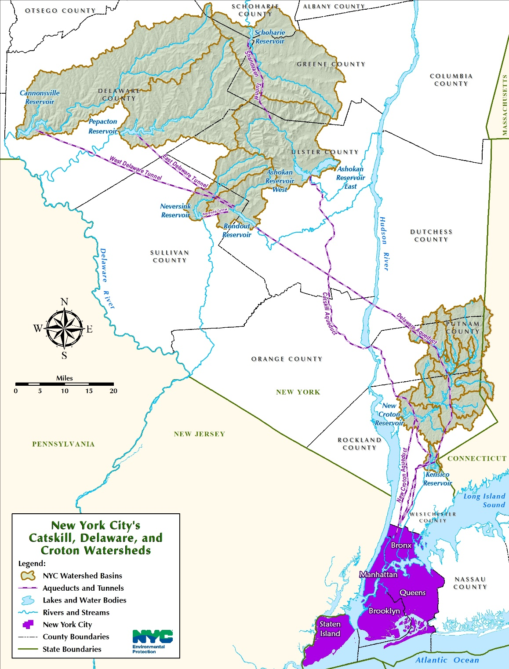
Three water supply systems
Croton System
Built 1830s – 1910s
First activated 1842
12 reservoirs and three lakes
Filtered supply
Typically accounts for 10 percent of NYC’s drinking water
Catskill System
Built 1907-1927
First activated 1915
Three reservoirs → unfiltered
Typically accounts for 40 percent of NYC’s drinking water
Delaware System
Built 1930s-1960s
First activated 1944
Five reservoirs → unfiltered
Typically accounts for 50 percent of NYC’s drinking water

Slide 5
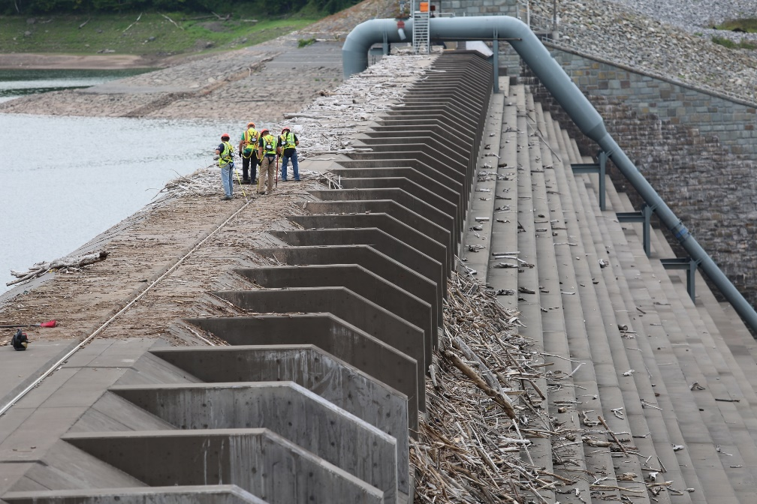
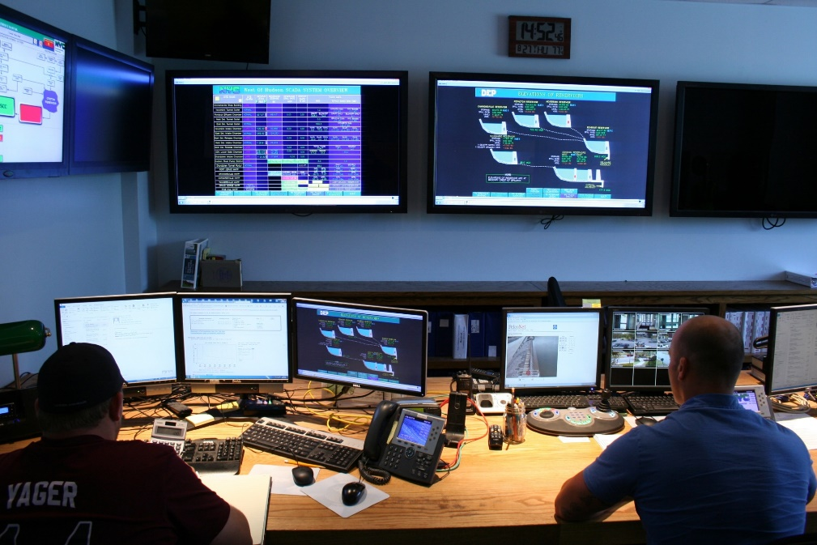
Source Water and Treatment Operations
Manages the delivery and treatment of more than 1 billion gallons/day
Responsible for maintenance of infrastructure that includes:
Over 280 water supply facilities
Water supply reservoirs & lakes
Treatment facilities:
Chlorine, UV, Fluoride, Croton Filtration Plant
36 shafts
391.7 miles of large aqueducts
29 water supply dams
57 bridges & 99 miles of roads
7 wastewater treatment facilities in the watershed
Operation of the works

Slide 6
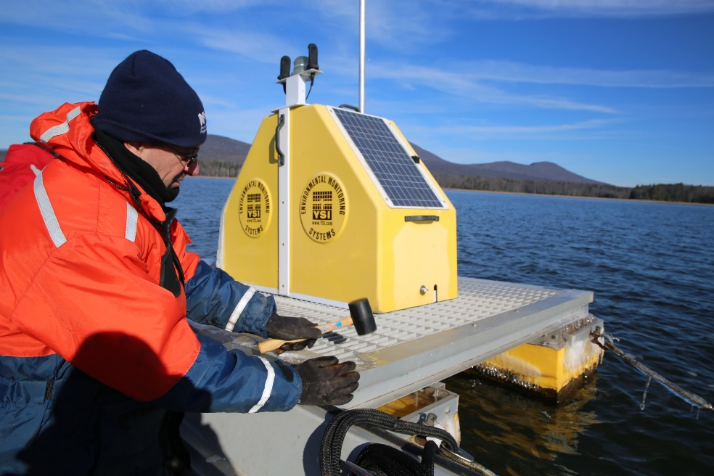
Water Quality
DEP tests NYC’s water nearly 2 million times each year
Ensures water supply meets all drinking water standards
Collects > 53,000 samples/year throughout the watershed and NYC distribution system.
Performs more than 654,000 laboratory analyses/year
Robotic monitoring = 1.3 million tests/year
Water Quality Monitoring Parameters
Pathogens – Giardia and Cryptosporidium
Microbiology – coliform bacteria, E. coli, phytoplankton
Nutrients – e.g. phosphorus and nitrogen
Physical Properties – e.g. turbidity, pH, temperature
Metals – e.g. lead, copper, mercury
Organic Compounds – e.g. disinfection by-products, pesticides
Process Control – e.g. chlorine, fluoride, conductivity
Approximately 240 different parameters
Notes:
Limno sampler is Allison Bennet
Robomon site - Ashokan
Continuous Monitoring (photo from Uptake 2 at Hillview Reservoir (officially known as Site 2).

Slide 7
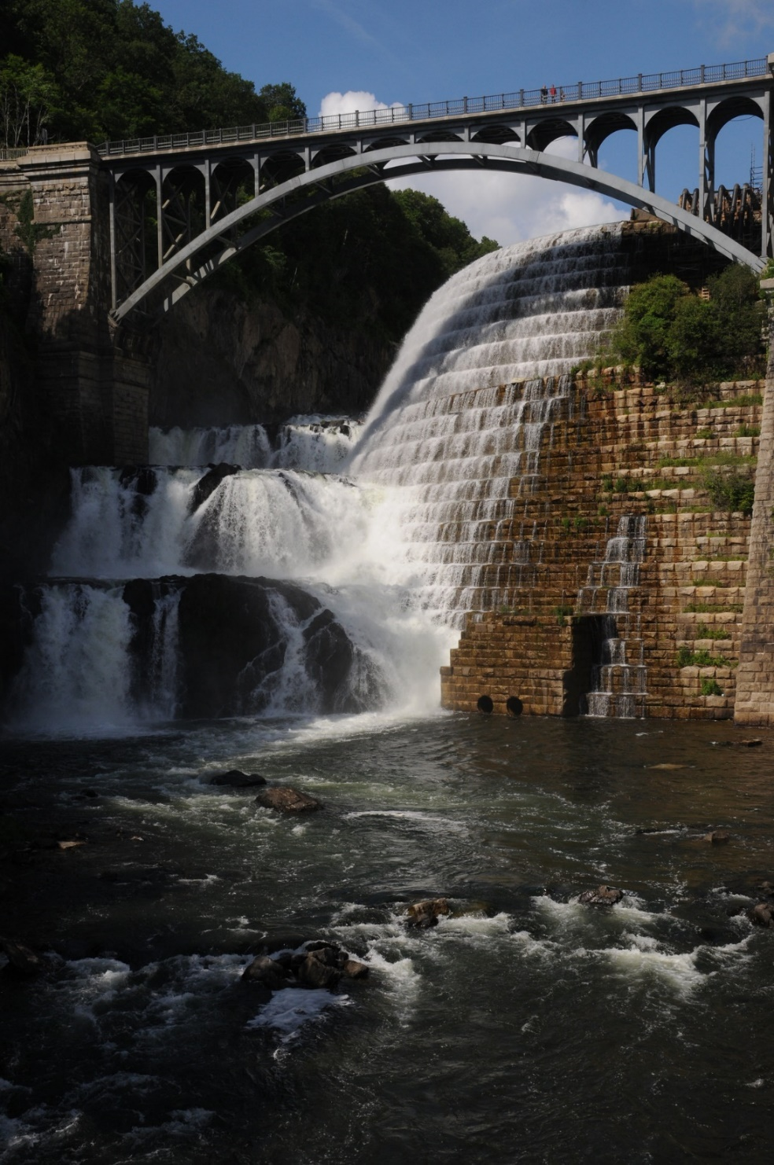
Operational framework
Essential Tasks
Meet the supply needs of New York City
Meet all reservoir release and diversion requirements
Maintain the system to ensure a dependable supply
Objectives
Send to New York City the best-quality water available in the system
Maintain a balanced system
Operate the system based on sound science → considerations for water quantity and quality
Release the necessary amount of water downstream without impact to the supply

Slide 8
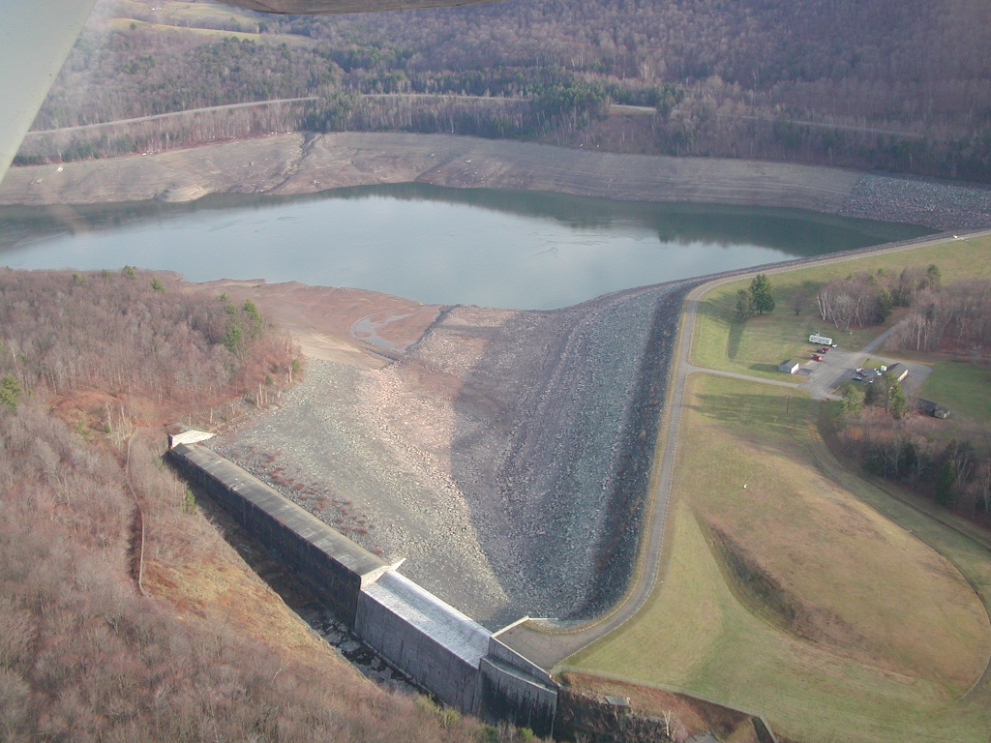
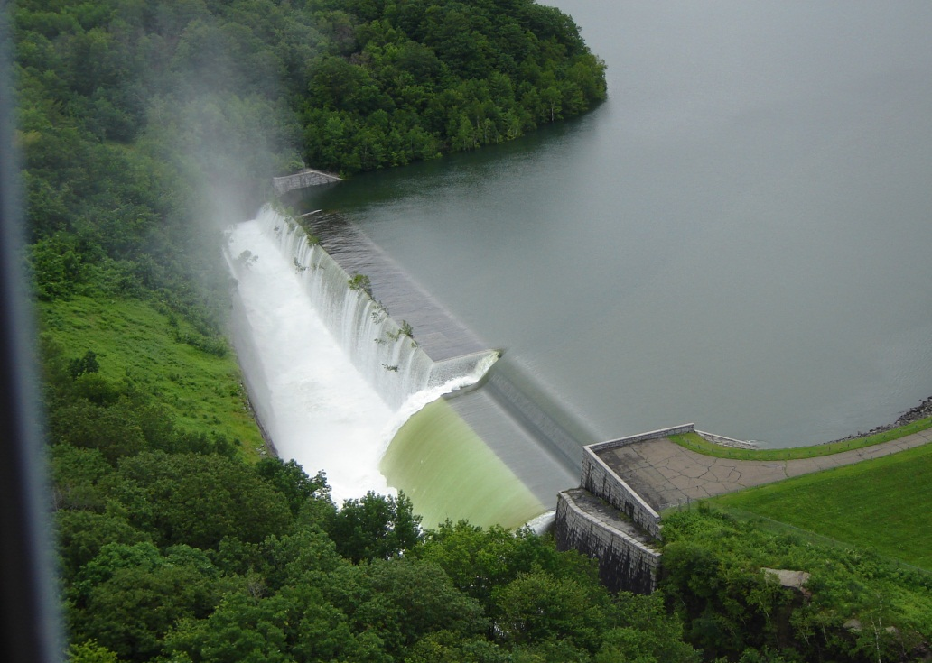
Balanced system
Operating a balanced system is key to protecting the City against droughts and coping with droughts when they happen
Concept: no sub-system or reservoir should be significantly more full or empty than another
Increases the chances of system-wide refill annually by June 1
Requires DEP to make hour-by-hour and day-by-day decisions about the sources of New York City’s water
Assisted by Operations Support Tool
Advanced computer model with more than 1,600 inputs
Runoff forecasts, stream gauges, reservoir instrumentation
Tracks probability of refill

Slide 9
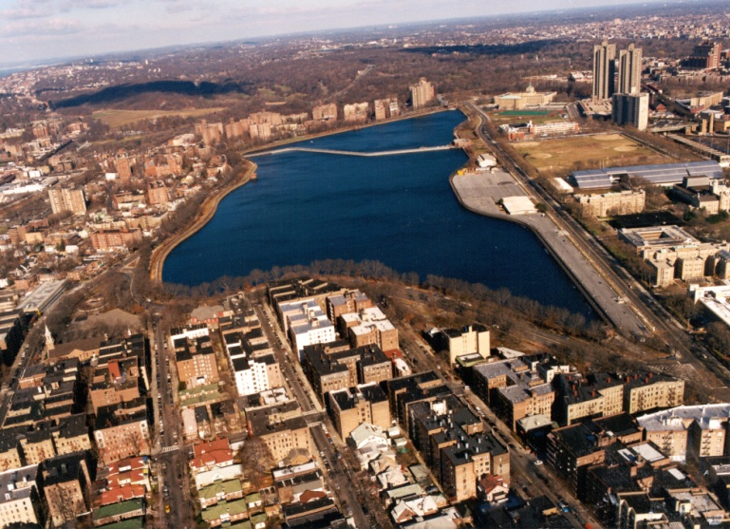
Croton System Operations
Typically accounts for 10 percent of New York City’s water (80-120 MGD)
Drawn from New Croton Reservoir via the New Croton Aqueduct
Typically fills the south basin of JPR
Water drawn from JPR into the Croton Water Filtration Plant
Dissolved air flotation, sand filtration, chlorination, UV
Water goes back into New Croton Aqueduct → Bronx and Manhattan
Additional Croton Water needed during droughts or infrastructure outages
Croton can provide as much as 30 percent of NYC’s water (290 MGD)

Slide 10
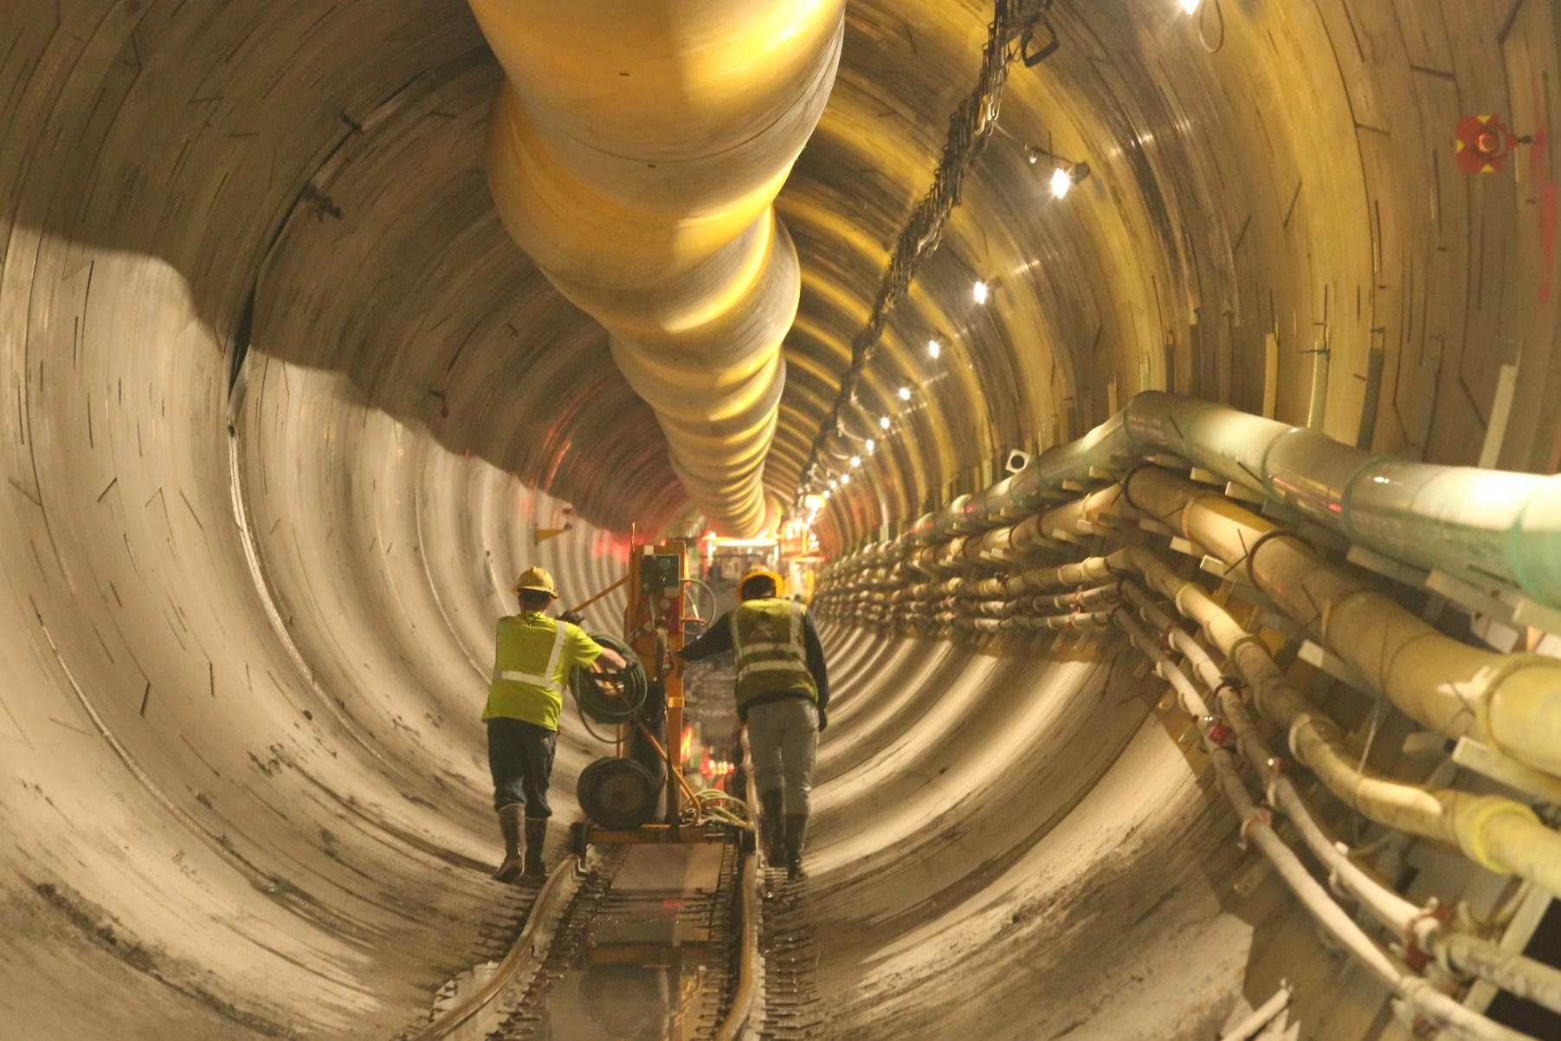
Upcoming infrastructure projects
Additional Croton System water will be needed to help NYC get through the following infrastructure projects:
Catskill Aqueduct Rehabilitation
10-week shutdowns in 2019 & 2020
Clean inside of aqueduct, replace more than 30 valves, fix leaks
Delaware Aqueduct Bypass Tunnel
Largest repair project in 177-year history of NYC water supply
Repair two areas of leakage in the world’s longest tunnel
Shutdown 5-8 months in 2022-2023
Ashokan Century Program (2020s)
Kensico-Eastview Connection (2020s-2030s)

Slide 11
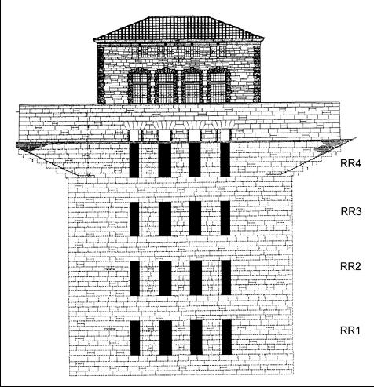
Selective Withdrawal
Operational changes and water quality
Significant water quality testing before DEP makes an operational changes
Buoy data and grab samples by our scientists
Scientific data used as the basis for selecting water source and depth
Water supply system includes multi-level intakes at reservoirs
Which depth within the reservoir has the best water quality?
Notes:
Selective Withdrawal
-DEP monitors water quality at different elevations within the reservoirs to determine the optimal level of withdrawal
-Diagram shows intake elevations at the Rondout Effluent chamber
-Change elevations to optimize water quality

Slide 12
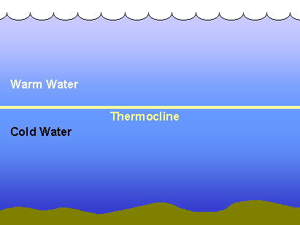
Selective Withdrawal
Operational changes and water quality
Reservoirs have a thermal structure most of the year
Warm water at the top, cold water at the bottom
Thermocline – or mixing layer – in the middle
DEP examines reservoir profile data to avoid drawing water from the thermocline
DEP ramping up Croton Supply in October 2018 to shut down Catskill Aqueduct for repairs
Thermocline moved in New Croton Reservoir
Resulted in a musty or earthy smell in the water for approximately 10 days
Thermocline Sept. 25, 2018
Intake level Sept. 25, 2018
Thermocline 2 weeks later
Thermocline Oct. 8, 2018
Notes:
Selective Withdrawal
-DEP monitors water quality at different elevations within the reservoirs to determine the optimal level of withdrawal
-Diagram shows intake elevations at the Rondout Effluent chamber
-Change elevations to optimize water quality

Slide 13
Croton distribution odor issue
Began ramping up on Sept. 26; noticeable uptick in 311 calls one week later
Calls came only from areas of BX / Manhattan receiving Croton water
Water had musty/earthy smell → similar to wet leaves breaking down in fall
311 calls peaked at 73 on Oct. 10
Water supply operators recognized the thermocline issue and changed to a high-level intake on Oct. 10 → calls began to decrease; conditions in Croton Filtration Plant returned to normal
DEP shut down the plant on Oct. 13, reactivated it Oct. 18
Notes:
We wont cite actual start date of 10/15 or other….”mid to late October”

Slide 14
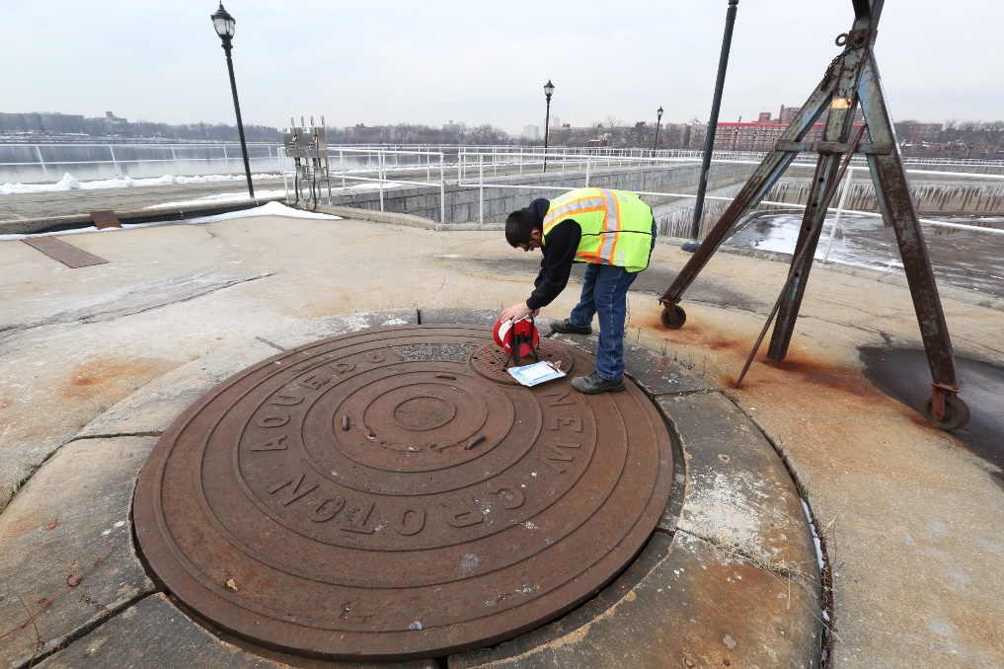
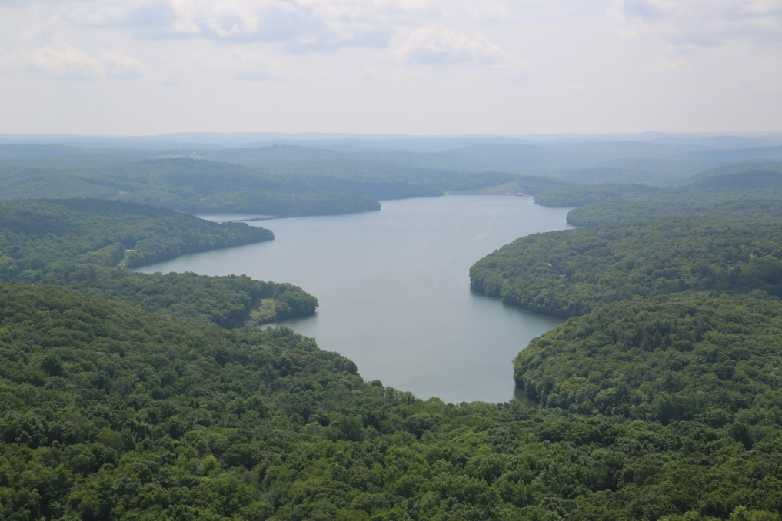
Causes of taste and smell
Surface water supplies throughout the world experience periodic changes in taste or smell
Often seasonal and always temporary
Taste and smell issues have many causes:
Fulvic and humic soils (not NYC)
Anoxia at the reservoir bottom (happens rarely in NYC water supply reservoirs)
Seasonal die-off of organic material (2018)
Phytoplankton die-off in New Croton Reservoir released taste-and-odor compounds → Geosmin and MIB
100 percent harmless, but cause changes to ambient features of the water
Taste and odor compounds cannot be filtered out
Croton Filtration Plant performed excellent removal of manganese, organics, sediment, etc. during the taste and smell issue
Issues with taste and odor extremely rare in NYC water → last issue was in Cat-Del System 2010
Chrysosphaerella → short term metallic taste
Notes:
We wont cite actual start date of 10/15 or other….”mid to late October”

Slide 15
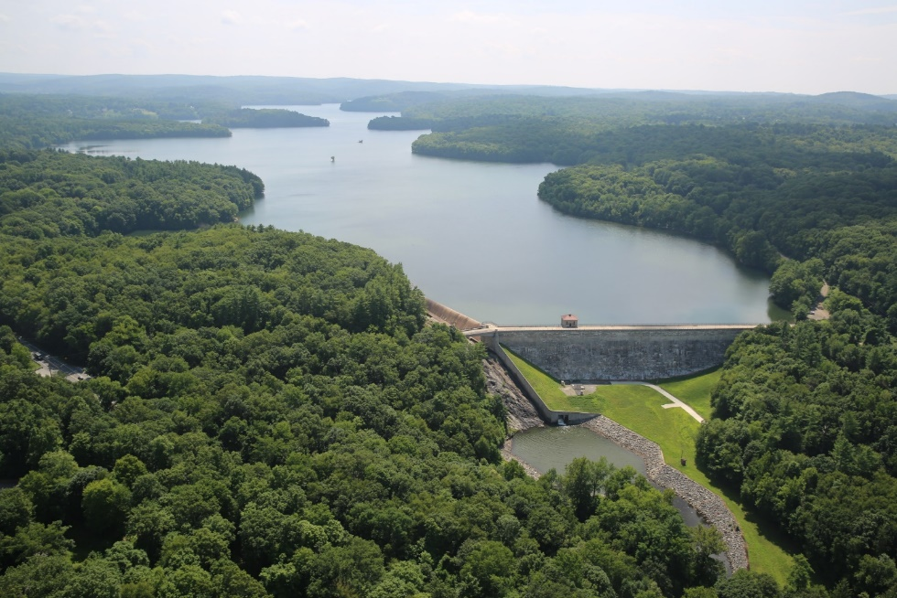
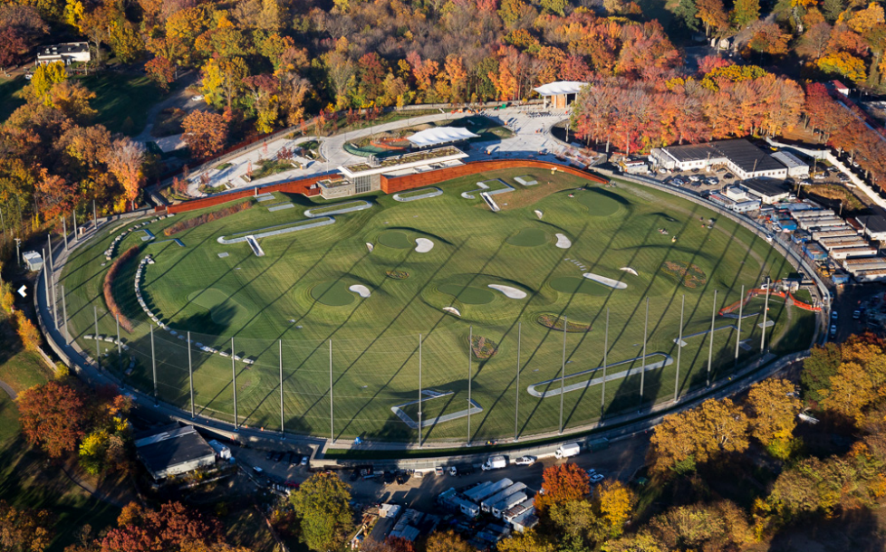
Efforts to prevent taste and smell changes
More intensive monitoring at New Croton Reservoir
Installation of real-time monitoring buoys at both intakes for a steady stream of information about position of thermocline
Exploration of methods to oxidize or absorb the taste-and-odor compounds before they reach distribution
DEP has met with several other water utilities throughout the United States and Europe to understand best practices
Jar testing in the laboratory
Increased testing for organic taste-and-odor compounds → ability to do it internally
Long-term research on causes and solutions through national and international bodies
Ultrasonic buoy pilot program at New Croton Reservoir
Notes:
We wont cite actual start date of 10/15 or other….”mid to late October”

Slide 16
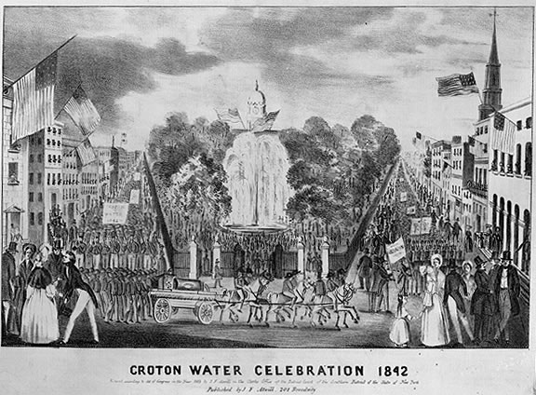
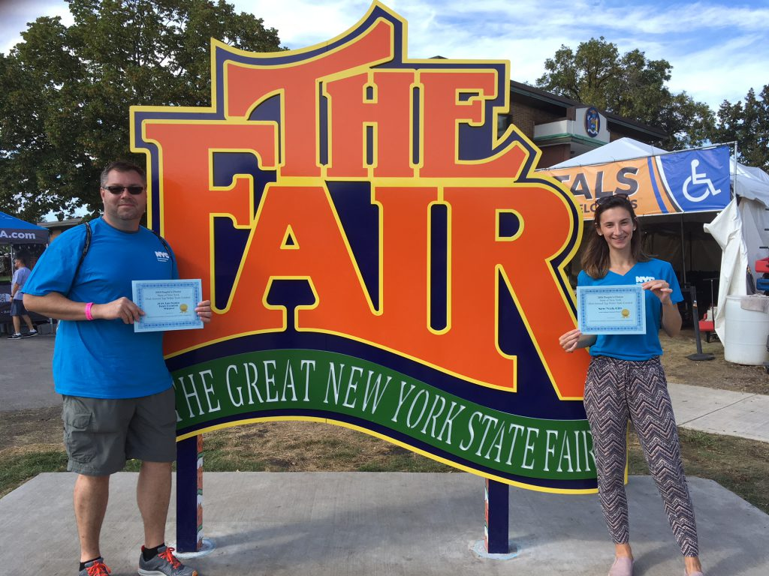
Croton Water Then and Now
Saved the City from unrelenting fire, disease and filth when activated in 1842
The original marvel of modern engineering
Gravity fed → 13.25 inches per mile
Largest dam in the world
Allowed NYC to grow from 200,000 people to 3.5 million in 73 years (1842-1915)
One of two big pieces of infrastructure that turned New York into the Empire State → Croton System and Eerie Canal
Croton System capacity and flexibility saves NYC from droughts (as recently as 2016)
Croton System capacity and flexibility helps NYC achieve infrastructure projects that would otherwise be improbable
NYC water won the 2018 New York State Drinking Water Taste Test → hailed as most delicious in all of New York

Slide 17
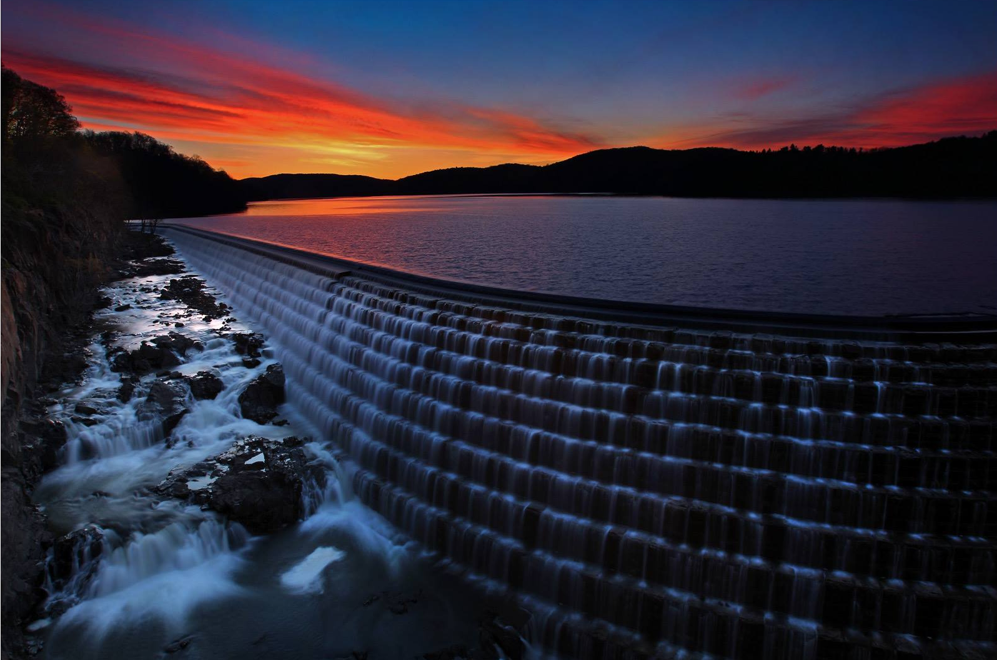
Questions and discussion…

